Slide 1

SOFTWARE TESTING
UE18CS400SB
Prof. Venkatesh Prasad
venkateshprasad@pes.edu
Department of Computer Science

Slide 2

SOFTWARE TESTING
Positive and Negative testing
Equivalence Partitioning
BVA
Decision Tables
Venkatesh Prasad
Department of Computer Science and Engineering

Slide 3
SOFTWARE TESTING
Positive and Negative Testing
Positive testing to check that the product does what it is supposed to
Behaves correctly when given right inputs
Maps to a specific requirement
“Coverage” is defined better
Negative testing to show that the product does not fail when given unexpected inputs
Tries to break the system
No direct mapping to a specific requirement
“Coverage” more challenging

Slide 4
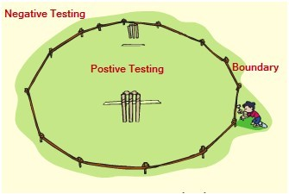
SOFTWARE TESTING
Positive and negative testing

Slide 5
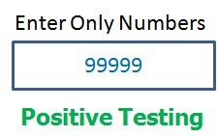
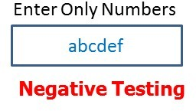
SOFTWARE TESTING
Positive and Negative Testing Example

Slide 6
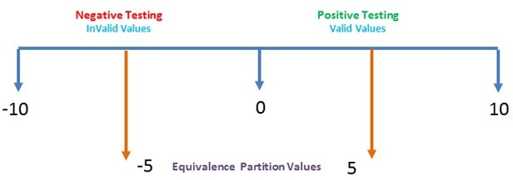
SOFTWARE TESTING
Positive and negative testing

Slide 7


SOFTWARE TESTING
Example – Positive and Negative Testing
Positive Testing
Test Req ID Case ID
Lock_1 BR-01
Lock_2 BR-02
Input 1
Input 2
Current State
Expected State
- Use key 1234
- Turn clockwise
Unlocked
Locked
- Use key 1234
- Turn anti-clockwise
Locked
Unlocked
Negative Testing
Test Req ID Case ID
Input 1
Input 2
Current State
Expected State
Lock_5 Lock_6
BR-04 BR-05
Use key 4567
Use Hair-pin
Turn clockwise
Turn anti-clockwise
Unlocked Locked
Unlocked Locked

Slide 8
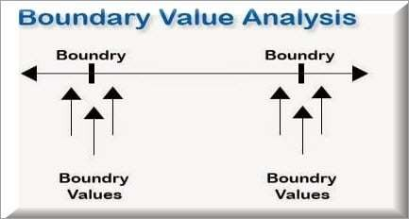
SOFTWARE TESTING
Boundary Value Analysis

Slide 9
SOFTWARE TESTING
Boundary Value Analysis
If we want to test a field where values from 1 to 100 should be accepted. then we choose the boundary values:
1-1,
1,
1+1,
100-1,
100, and
100+1.
Instead of using all the values from 1 to 100, we just use 0, 1, 2, 99, 100, and 101.

Slide 10
SOFTWARE TESTING
Boundary Value Analysis
Most defects come up near “boundaries”
Reasons from a white box perspective:
Programmers tentativeness in using the right relational operator (< or < = ?)
Multiple ways of implementing loops
Confusing array subscripts
Reasons from a black box perspective:
Unclear requirements
Ambiguous or “it depends” mindset!

Slide 11
SOFTWARE TESTING
Boundary Conditions – Example 1: Database Buffers
Boundary value analysis extremely useful when there are limits on internal data structures, resources and variables
Database starts with a pre-allocating number of buffers for caching
Buffers filled up as needed
If full, buffers freed on a FIFO basis

Slide 12
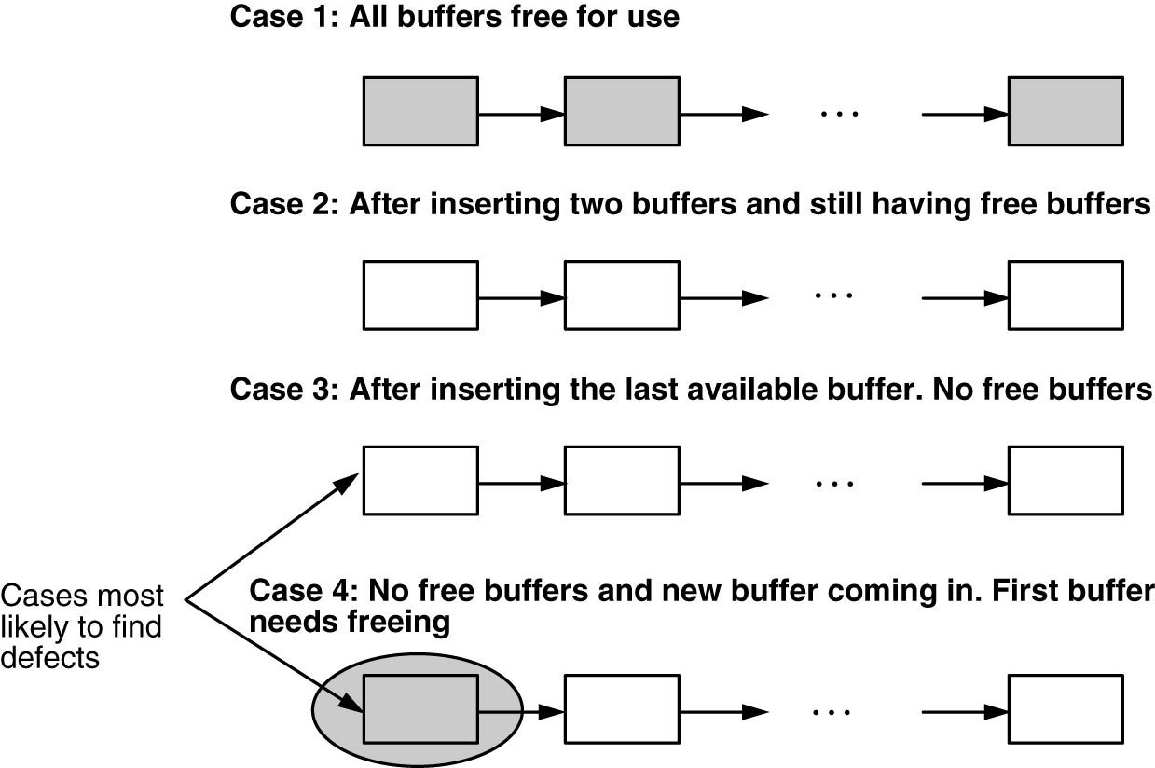
SOFTWARE TESTING
Boundary Conditions – Example 1: Database Buffers

Slide 13

SOFTWARE TESTING
Example 2: Volume Discount Calculations
Product pricing depends on the quantity procured
Based on pre-defined “slabs”
Number of Units Bought Price per Unit
First Ten Units (1 – 10) | $ 5.00
Next Ten Units (11 – 20) | $ 4.75
Next Ten Units (21 – 30) | $ 4.50
More than 30 Units | $ 4.00

Slide 14
SOFTWARE TESTING
Example 3 – Sample Test Cases
Input to be tested | Test Objective | Expected value of output
1 | Lower Boundary of First Slab | $ 5.00
5 | Any value in First Slab | $ 25.00
9 | Higher Boundary of First Slab | $ 45.00
10 | Limit of First Slab | $ 50.00
11 | Lower Boundary of Second Slab | $ 54.75
16 | Any value in Second Slab | $ 78.50
19 | Higher Boundary of Second Slab | $ 92.75

Slide 15
SOFTWARE TESTING
Solution: BVA
Variable | Input to be tested | Test Objective | Expected value of output
 | 15 | < 18 | Error
 | 17 | Below Lower limit | Error
 | 18 | Lower Limit | $200
Age | 19 | Above Lower Limit | $200
(18 and 65
 | 35 | Any value in the Slab | $200
as
 | 64 | Below Upper Limit | $200
boundaries)
 | 65 | Upper Limit | $150
 | 66 | Above Upper Limit | $150

Slide 16
SOFTWARE TESTING
Solution: BVA
Variable | Input to be tested | Test Objective | Expected value of output
Income (10000 as boundary) | 8000 | < 10000 | $200
 | 9999 | Below Lower limit | $200
 | 10000 | Lower Limit | $250
 | 10001 | Above Lower Limit | $250
 | 12000 | > 10000 | $250

Slide 17
SOFTWARE TESTING
Boundary Value Analysis (BVA): Summary of Process
Look for any kind of gradation or discontinuity in data values that affects computation – the discontinuities are the boundary values, requiring thorough testing.
Look for any internal limits like limits on resources (like the example of buffers given above). The behaviour of the product at these limits should also be the subject of boundary value testing.
Also include in the list of boundary values, documented limits on hardware resources. For example, if it is documented that a product will run with minimum 4MB of RAM, make sure you include test cases for the minimum RAM (i.e., 4MB in this case).
The examples given above discuss boundary conditions for input data – the same analysis needs to be done for output variables also.

Slide 18
SOFTWARE TESTING
Decision Based Testing
A program’s behaviour is characterized by several decision variables.
Each decision variable specifies a boolean condition.
The distinct combinations of these decision variables lead to different scenarios.
Each scenario occupies a row in the decision table, and the row also has expected results.
One representative data point from each scenario needs to be tested.

Slide 19

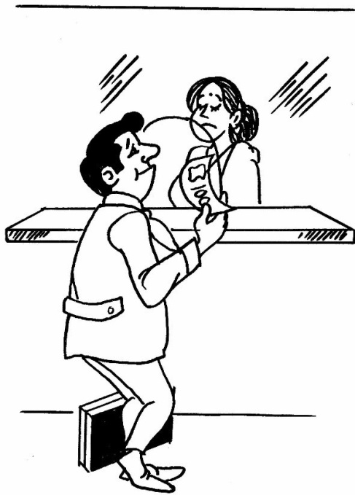
SOFTWARE TESTING
Decision Based Testing: Example
Conditions
Standard Deductions
Marital Status
- Single | $ 4,750
- Married, Joint Returns | $ 9,500
- Married, Separate Returns | $ 7,000
Age
- Either Filer or Spouse is 65 years or above
Additional
$1,000
Blind
- Either Filer or Spouse is Blind
Additional
$1,000

Slide 20
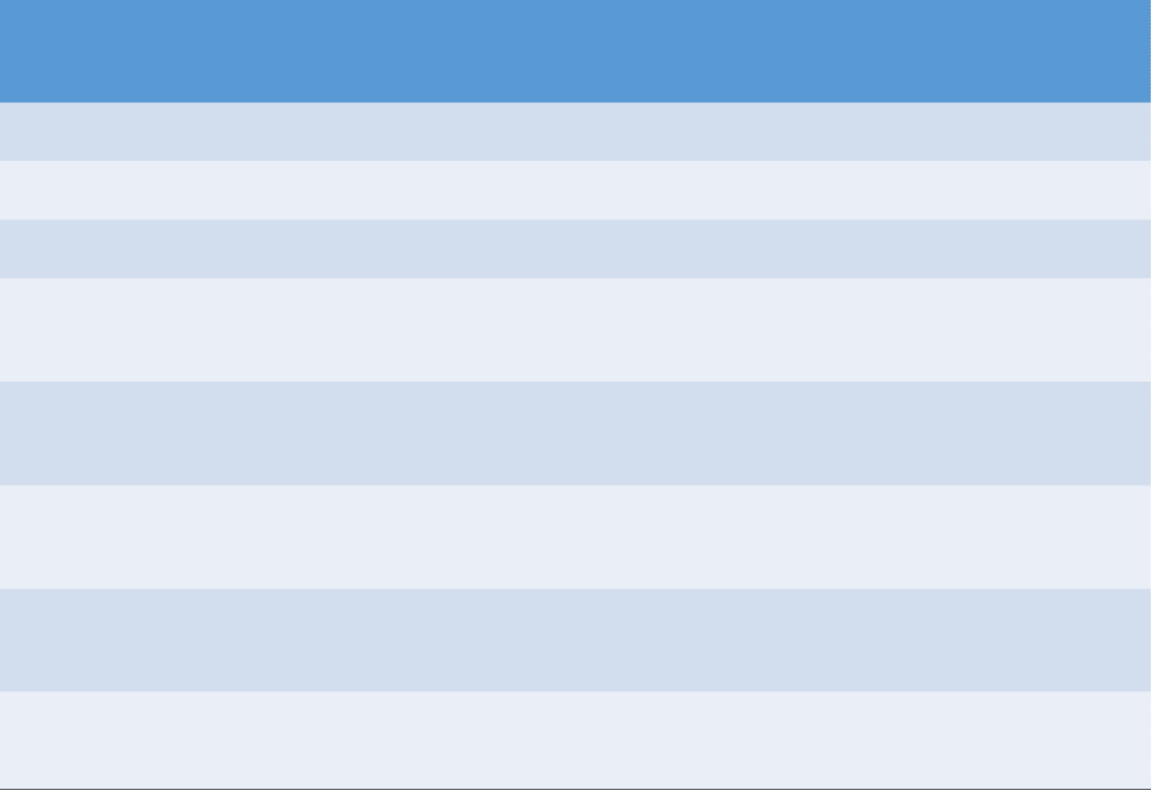
SOFTWARE TESTING
Sample Test Cases for Decision Tables
Marital Status
Age (Filer or Spouse?)
Blind (Filer or Spouse?)
Standard Deductions
$ 4,750
$ 5,750
$ 5,750
$ 7,000
Single Single Single
Married, Separate Returns
Married, Joint Returns
Married, Joint Returns
Married, Joint Returns
Married, Separate Returns
-
-
-
>65
-
-
Y
-
-
-
$ 9,000
-
Spouse
$ 10,000
Filer > 65
-
$ 10,000
Both > 65
-
$ 8,000

Slide 21
SOFTWARE TESTING
Decision Tables
If there are logical relationships like:
If
{
(Condition = True) then action1 ;
}
else action2; /*(condition = False)*/
Then a tester will identify two outputs (action1 and action2) for two conditions (True and False).
So based on the probable scenarios a Decision table is carved to prepare a set of test cases.
A decision table is a black-box test technique that visually presents combinations of inputs and outputs, where inputs are conditions or cases, and outputs are actions or effects.

Slide 22
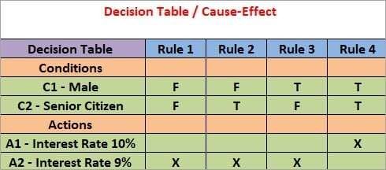
SOFTWARE TESTING
Decision Tables
For Example:
Take an example of XYZ bank that provides interest rate for the Male senior citizen as 10% and for the rest of the people 9%.

Slide 23
SOFTWARE TESTING
Decision Tables
condition C1 has two values as true and false,
condition C2 also has two values as true and false.
The number of total possible combinations would then be four.
This way we can derive test cases using a decision table.

Slide 24
SOFTWARE TESTING
More Examples…
The basic membership fee to a club only for adults above 18 years is $200, however, this fee can increase or decrease depending on three factors: their age, income, and their marital status. Customers that are above the age of 65 have their fee decreased by $50. Customers that have income above $10000 per month have their fee increased by $50. Customers that are married get a fee increase of 10%.
Derive test cases and test data for the following Black Box Software testing methods:
Equivalence Partitioning
Boundary Value Analysis
Decision Table

Slide 25
SOFTWARE TESTING
Summary of Decision Table
Identify the decision variables.
Identify the possible values of each of the decision variables.
Enumerate the combinations of the allowed values of each of the variables.
Identify the cases in which values assumed by a variable (or by sets of variables) are immaterial for a given combination of other input variables. Represent such variables by the Don’t Care symbol.
For each combination of values of decision variables (appropriately minimized with the Don’t Care scenarios), list out the action or expected result.
Form a table, listing on each but the last column one decision variable. On the last column, list the action item for the combination of variables in that row (including Don’t Cares, as appropriate)

Slide 26
SOFTWARE TESTING
Equivalence Partitioning (EVP)
Equivalence partitioning or equivalence class partitioning (ECP) is a software testing technique that divides the input data of a software unit into partitions of equivalent data from which test cases can be derived.
Generalization of BVA / decision table
Divide the (potentially infinite) set of values into a set of equivalence classes or partitions
One element of the class can act as a representative for the entire class
Results of the test for that one element is extrapolated to all the other elements
https://www.geeksforgeeks.org/equivalence-partitioning-method/

Slide 27
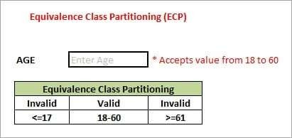
SOFTWARE TESTING
Equivalence Partitioning

Slide 28
SOFTWARE TESTING
Equivalence Partitioning
As present in the above image, an “AGE” text field accepts only the numbers from 18 to 60. There will be three sets of classes or groups.
Two invalid classes will be:
Less than or equal to 17.
Greater than or equal to 61.
One valid class will be anything between 18 to 60.

Slide 29
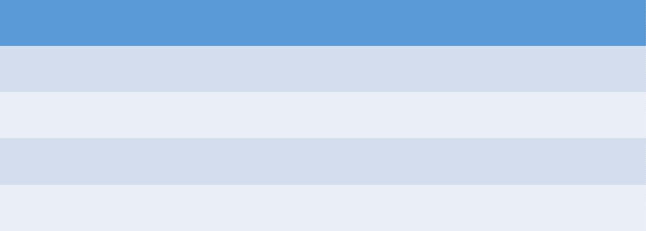
SOFTWARE TESTING
Example of EVP
Life Insurance Premium Rates
Age group
20 – 35
36 – 49
50 – 65
66+
Additional Premium Base = $5.00 Base + $ 1.00 Base + $ 2.00 Base + $ 5.00

Slide 30
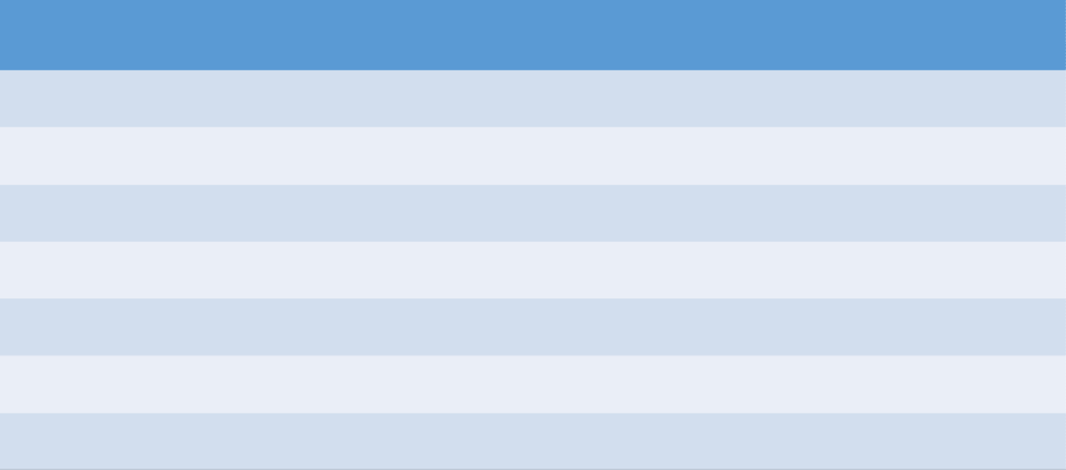
SOFTWARE TESTING
Example of EVP
Sample Age Groups Test Cases
Age Groups Type Test Inputs Expected Result
Below 20
20 – 35
36 – 49
50 – 65
Above 66
Age 0 Negative Age
Invalid Valid Valid Valid Valid Invalid Invalid
12, 18
22, 31
37, 44
52, 60
68, 94
0
-23
Error
$ 5.00 Premium
$ 6.00 Premium
$ 7.00 Premium
$ 10.00 Premium Error
Error

Slide 31
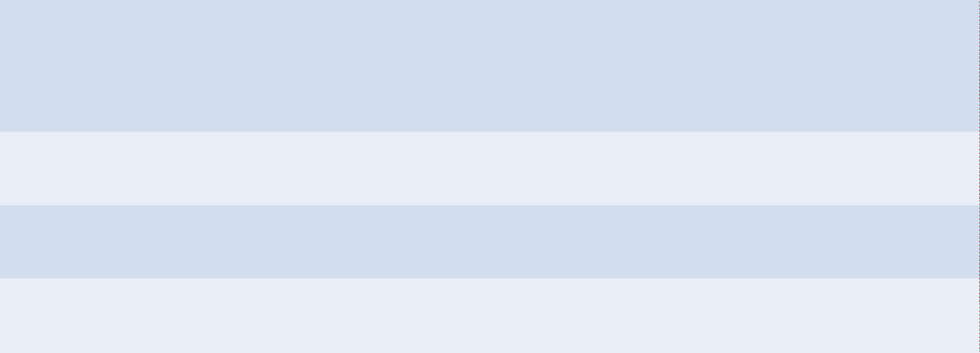

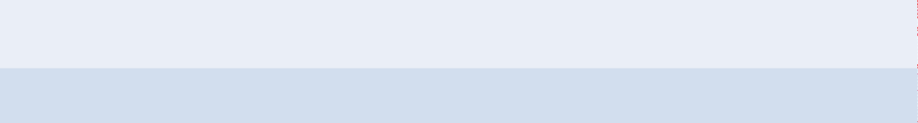
SOFTWARE TESTING
Solution: EVP
Variable | Classes | Type | Inputs | Exp. Fee
Age | Zero or Non numeric | Invalid | 0, Old | Error
 | < 18 | Invalid | 16 | Error
 | < 65 | Valid | 35 | $ 200
 | > 65 | Valid | 70 | $ 150
Income | Zero or Non numeric | Invalid | 0, None | Error
 | > 10000 | Valid | 12000 | $250
 | < 10000 | Valid | 8000 | $200
Marital Status | Married | Valid | - | $220
 | Single | Valid | - | $200

Slide 32
SOFTWARE TESTING
Summary of Process for EVP
Choose criteria for doing the equivalence partitioning (range, list of values, etc.).
Identify the valid equivalence classes based on the above criteria (number of ranges, allowed values, etc.) .
Select a sample data from that partition.
Write the expected result based on the requirements given.
Identify special values, if any, and include them in the table.
Check to have expected results for all the cases prepared
If the expected result is not clear for any particular test case, mark appropriately and escalate for corrective actions. If you cannot answer a question, or find an inappropriate answer, consider whether you want to record this issue on your log.

Slide 33
SOFTWARE TESTING
State- or Graph-Based Testing
Useful for
Language processors or compilers
Workflow modelling
Dataflow modelling

Slide 34
SOFTWARE TESTING
Example of Graph-Based Testing for an SQL Command
SELECT
1
*
2
FROM
,
<table name>
WHERE
…
3
4
5
6
<col name>
<table name>
,
FROM
7

Slide 35
SOFTWARE TESTING
Process for Language processors Testing Using Graph Method
Identify the grammar for the scenario. In the above example, we have represented the diagram as a state machine. In some cases, the scenario can be a context-free grammar, which may require a more sophisticated representation of a “state diagram”.
Design test cases corresponding to each valid state-input combination.
Design test cases corresponding to the most common invalid combinations of state-input.

Slide 36
SOFTWARE TESTING
Example of Graph-Based Testing for a Workflow
Requisition
Approving Authority
Approval
Requestor
Finance
Budget Update &
Purchase Order
Delivery
Note
Available Off the shelf
Buy & Expense
(Transaction:
Expense Report)
Payment
Received
Item
Vendor

Slide 37


SOFTWARE TESTING
Workflow Modelling
Manager
Feasible
Employee Desires Leave
Verify
Eligibility
Ensure
Feasibility
Approve
Eligible
Leave Application Form
Not Feasible
Ineligible
Reject

Slide 38
SOFTWARE TESTING
Workflow based testing
Current State | Test Condition | Expected Target State
- | Apply Leave | Awaiting Verification of Eligibility
Awaiting Verification of Eligibility | Eligible to take leave | Awaiting Manager Approval
Awaiting Verification of Eligibility | Not eligible to take leave | Rejected
Awaiting Manager Approval | Leave Feasible | Approved
Awaiting Manager Approval | Leave not Feasible | Rejected

Slide 39
SOFTWARE TESTING
General Characteristics of Graph-Based Testing
The application can be characterized by a set of states.
The data values (screens, mouse clicks, etc.) that cause the transition from one state to another are well understood.
The methods of processing within each state to process the input received are also well understood.

Slide 40
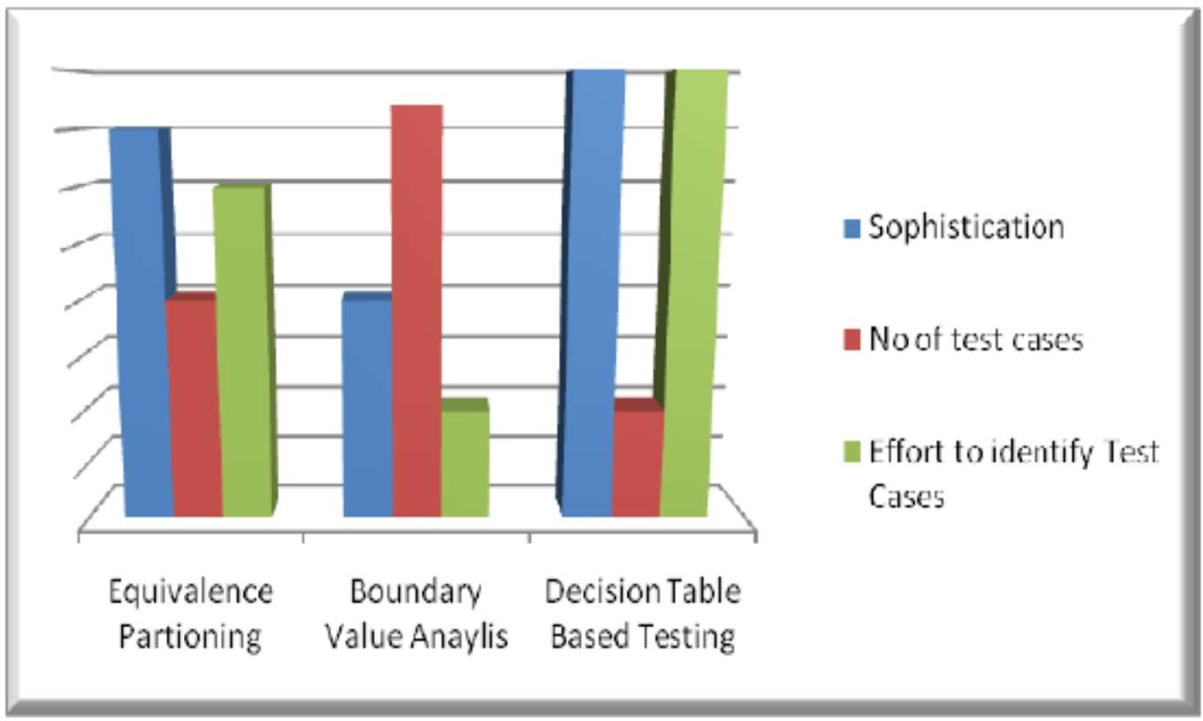
SOFTWARE TESTING
Comparison of some test techniques
Source: Internet

Slide 41
SOFTWARE TESTING
When to Use What…
When you want to have test scenarios that… | The most effective black box testing technique is likely to be…
Output values are dictated by certain conditions depending upon values of input variables | Decision Tables
Input values being in ranges, with each range exhibiting a particular functionality | Boundary Value Analysis
Input values being divided into classes (like ranges, list of values, etc), with each class exhibiting a particular functionality | Equivalence Partitioning
Check for expected and unexpected input values | Positive and negative testing
Workflows, process flows or language processors | Graph based testing
To ensure that requirements are tested and met properly | Requirements Based Testing

Slide 42

THANK YOU
Prof. Venkatesh Prasad
venkateshprasad@pes.edu
Department of Computer Science

